Slide 1
The Relational Model
Can explain the basic concepts of the relational model

Slide 2
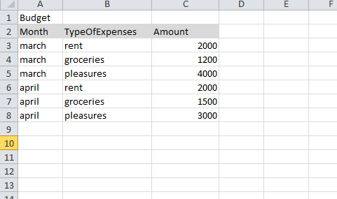
Analogy to tables eg. spreadsheets

Slide 3
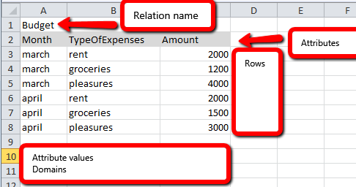
Analogy to tables eg. spreadsheets
SpreadsheetLikeRelationalModel.xlsx

Slide 4
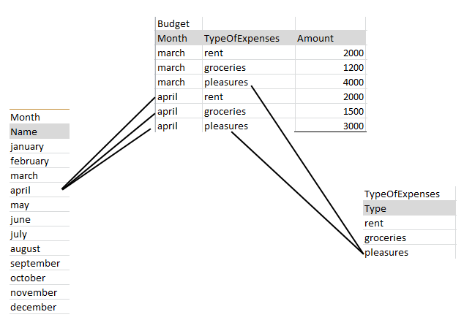
Analogy to tables eg. spreadsheets
Relationships among sheets

Slide 5

Analogy to tables eg. spreadsheets
Relationships among sheets
Tool: https://www.draw.io/

Slide 6
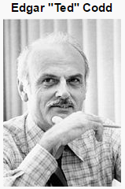
The Relational Data Model
Introduced by Ted Codd in 1970
First early implementations in early 1980s.
Success due to:
Simple
Based on a solid mathematical foundation

Slide 7
The Relational Data Model
Based on concept of mathematical relation (like a table of values)
Set theory
First-order predicate logic
Associated languages:
Formal
Relational algebra
Relational calculus
Structured Query Language (SQL)

Slide 8
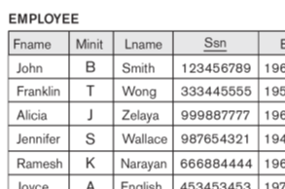

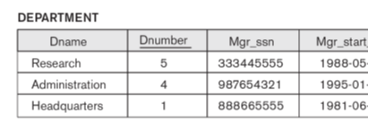
Relational Databases – Crash Course
All data in tables.
All rows have a primary key.
Tables may refer to other tables by foreign keys that point to primary keys in other tables.

Slide 9
Relational Model Concepts
Database: The relational model represents the database as a collection of relations.
Informally, each relation resembles a table of values.
Some concepts:
Relation
Relational schema
Tuples
Attributes
Domains

Slide 10
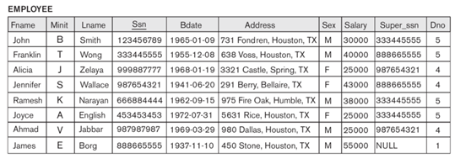
Relational Model Concepts
Primary key
Foreign key
Relation
Tuples
Attributes
Null value

Slide 11
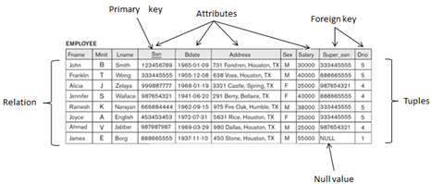
Relational Model Concepts
Data is organised in a number of tables (relations).
Each table has a number of (>=1) columns (attributes).
Attributes have names and domains
Attribute values are atomic and defined over some domain.
A table holds a number of (maybe none) rows (tuples).
Tuples are unordered.
Tuples are unique (existence of a key is guaranteed).
A relation is a set (mathematical) of tuples.

Slide 12
Attributes and Domains
A domain defines the valid values of an attribute.
Logical definitions of domains. Like attribute: Social_security_number The set of valid nine-digit Social Security numbers. Like attribute: Academic_department_names The set of academic department names in a university, such as Computer Science, Economics, and Physics.
Theoretically it should be possible to define problem specific domains as ssn-numberss, ip-addresses, etc.

Slide 13
Attributes and Domains
A domain defines the valid values of an attribute.
Domain:
Name
Type
Format
..
In practice:
Domains are based on the built-in standard data types (int, char, etc) offered by the DBMS.
Plus additional specification

Slide 14
NULL
An attribute may have the value “empty”. Empty is notated NULL.
Several meanings for NULL values, such as:
value unknown
value exist but is not available
attribute does not apply to this tuple (also known as value undefined).
Comparison is ambiguous (NULL = NULL ?)
SQL: IS NULL / IS NOT NULL
…where… age = NULL WRONG .
…where… age IS NULL CORRECT .
Think: person.id = dog.person_id
Two different dogs, in both cases dog.person_id is NULL.
Does it mean that they both have the same, unknown / missing owner? Maybe, maybe not. We don’t know, that’s why NULL ≠ NULL

Slide 15
DEFINITION SUMMARY
Informal Terms | Formal Terms
Database | Set of relations
Table | Relation
Column | Attribute
Row | Tuple
Type | Domain
Table Definition | Schema of a Relation

Slide 16
Constraints
There are generally many restrictions or constraints on the actual values in a database state.
Constraints on databases can generally be divided into three main categories:
.. inherent in the data model, called : inherent model-based constraints or implicit constraints.
.. expressed in schemas of the data model (using DDL), called: schema-based constraints or explicit constraints
.. cannot be directly expressed in the schemas of the data model, and hence must be expressed and enforced by the application programs, called: application-based or semantic constraints or business rules.

